Slide 1
Action Plan
Guo Li, Senior Agriculture Economist, World Bank, Washington D.C. USA
Abdul Fattah Tunio, Member (Development) Planning and Development Department, Government of Sindh, Pakistan.
Hidayatullah Chhajro, Project Director, Director General Agriculture Extension, Government of Sindh, Pakistan.
Aftab A. Solangi, Chief M&E Specialist, SAGP, Agriculture Department, Government of Sindh, Pakistan.
Digital agriculture workshop – south Korea 26^{th -} 30th August, 2019

Slide 2
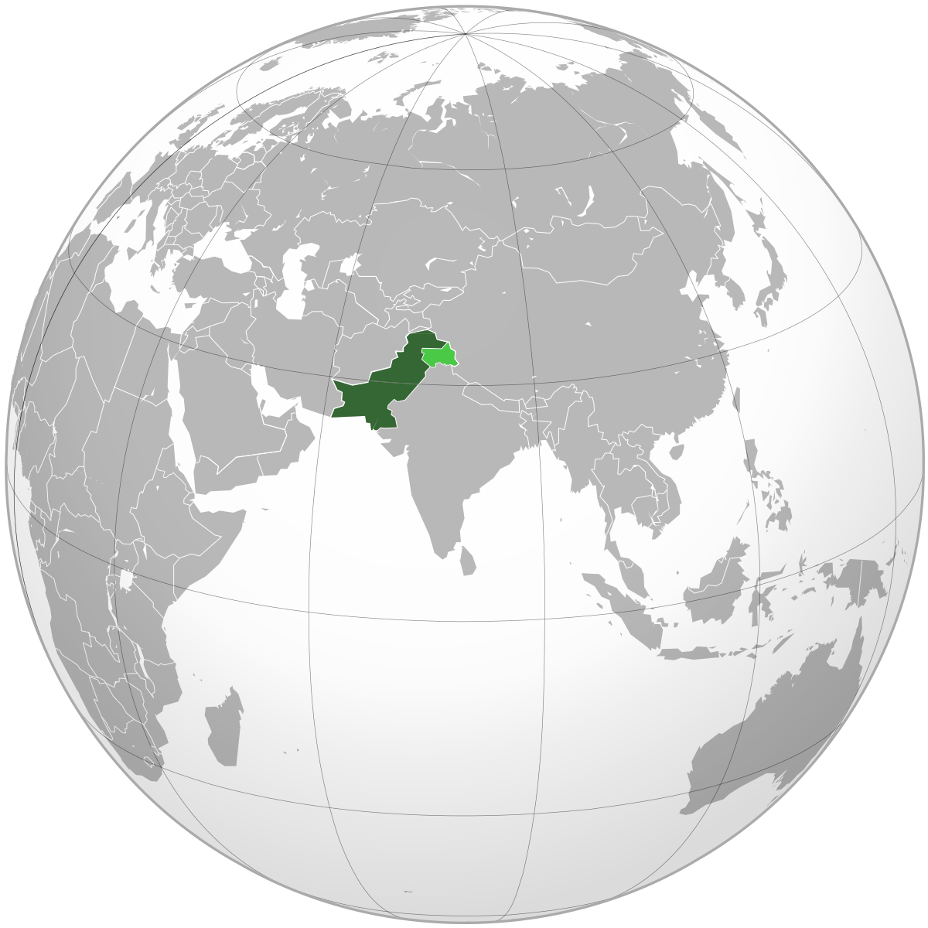
Pakistan on globe

Slide 3
1. Takeaways
Digital Technologies of Future
Governments Role in Creating Eco-System.
PPP – Implementation
Agriculture Entrepreneurship
(Everyone can be a smart farmer)
Country presentation – Pakistan

Slide 4
Country presentation – Pakistan
2. Challenges
Yield Gap
Less Skills (GAP & Gender Equality)
Poor Inputs (Seed, Irrigation, Production Technology etc.)
Post-Harvest Losses
Population growth (2.1%),
Migration to Urban centers
Climate Change
Market Linkages
Connectivity / Energy Gap

Slide 5
3. Actions to Be taken
Short Term:
Digital Agriculture Policy (Database, GIS, Connectivity)
Medium Term:
Quality Inputs
Capacity Building and institutional Development
Good Practice (GAP & HEIS)
Crop Diversification
Market Linkages
E-Platform
Agro-Processing / Value Chain
Storage Facilities
Market Grants for Startups
Long Term
Agriculture Enterprises
Country presentation – Pakistan

Slide 6
4. Opportunities & Barriers
Opportunities
Availability of Technology
Good Agriculture Resources (Land, Water, Climate, Manpower, Geographical Location
Government Willingness
Barriers
Technology Gap
Inadequate Policy and Regulations
Lack of Quality Education
Lack of Adequate Infrastructure Under Agriculture Extension/ Research
Imbalance Resource Allocation to Agriculture Sector
Country presentation – Pakistan

Slide 7
5. Technical assistance
Digital Agriculture
Technology transfer
Capacity Building and Institutional Development
Agriculture Business Enterprise
Enabling environment for FDI
Country presentation – Pakistan

Slide 8
Country presentation – Pakistan
Thank you

